Slide 1
Getting Ahead of Head Lice
Margaret Bultas, PhD, RN, CNE, CNL, CPNP-PC
Associate Professor
Trudy Busch Valentine School of Nursing
Saint Louis University

Slide 2
Objectives
Describe currently available evidence-based treatments to manage pediculosis.
Describe epidemiology, transmission, manifestations, and identification of pediculosis.
Develop strategies to manage challenging situations related to pediculosis including treatment, communication with families and school personnel, and school policies.
Identify resources available to support school nurses in managing pediculosis.

Slide 3
Head Lice are Parasites
Head lice (Pediculus humanus capitis)
Do not transmit disease
Most commonly seen in children
Public lice (Pthirus pubis)
Do not transmit disease
More commonly seen in adults
Body lice (Pediculus humanus corporis)
Can transmit disease
More commonly seen in adults
All require a human host to survive
Notes:
Although school nurses manage a variety of illnesses and issues, one of the more delicate issues to address is that of head lice.
Lice are parasites
Head and pubic lice pose few health hazards. Mostly annoyance. Neither are known to transmit disease. But they do cause anxiety and strong emotional responses from students, parents, educators.
6-12 million cases of lice occur each year in the US in children ages 3-11 years of ade.

Slide 4
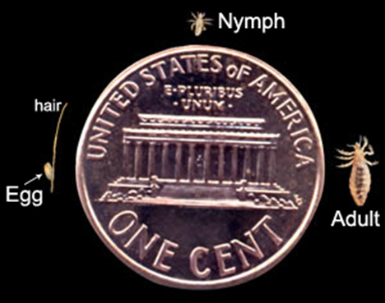
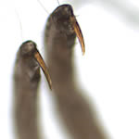
Lice
Tiny (2-3 mm)
Each female lays 5-10 eggs (nits)
Warm body temperature incubates them
Hatch in 7-12 days, then matures and lays eggs in 9-12 days.
Change color and strong claws—adaptable to hair types
Has to feed or will die in 24-48 hrs
Saliva causes the itching
Transmitted by humans, not animals
Notes:
Adult 2-3 mm in length. Six legs, strong claws to grasp hair shaft
Female lays 5-10 eggs and they are firmly attached to hair shaft just above the scalp. The warm body incubates them.
Nits hatch in 7-12 days. They mature through the nymph stage after 9-12 days and become adults, lay eggs and repeat the cycle.
They can alter their color and adapt to different hair types.
They must feed or they will die in 24-48 hours without a food supply.
The saliva causes the itching. It takes 4-6 weeks to be sensitized to the itching the first exposure but after that, itching occurs within a day or two of exposure.
They are not transmitted through animals

Slide 5
Transmission
Most commonly through head-to-head contact.
Sleep, sharing beds, preschool age during play
Less commonly transmitted through fomites (brushes, combs, hats)
Cannot jump, fly, or hop
Cannot live more than 1-2 days off host
Due to this, transmission in most school classroom settings is low
Transmission more likely in homes that have close contact

Slide 6
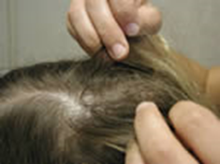
How Do You Know They Have It?
Redness, itching, excoriation of the scalp
Itching may not onset as quickly in first case
Scalp scaling or infection
Poor sleep, irritability
Visualization of viable nits
Attached firmly just above the scalp
Empty casings are not viable
Easiest to see at the hairline, occipital area, behind the ears
Lymphadenopathy (cervical, suboccipital)
Need to be able to identify and find at least 1 live louse
Notes:
A fine-tooth comb and wetting of the hair may help in the identification of a live louse.
Diagnosis and treatment should not occur unless you can find at least 1 live louse.

Slide 7
Treatment Options
Over-the-counter pharmacologic
These generally are the recommended first line treatments for uncomplicated cases.
Safety profiles are good with minimal toxicity
Prescription pharmacologic
Includes both topical and oral treatments
Alternative & Non-pharmacologic
Fewer studies have been completed on these treatment regimens
NO LINDANE 1%--this is no longer used due to safety concerns

Slide 8
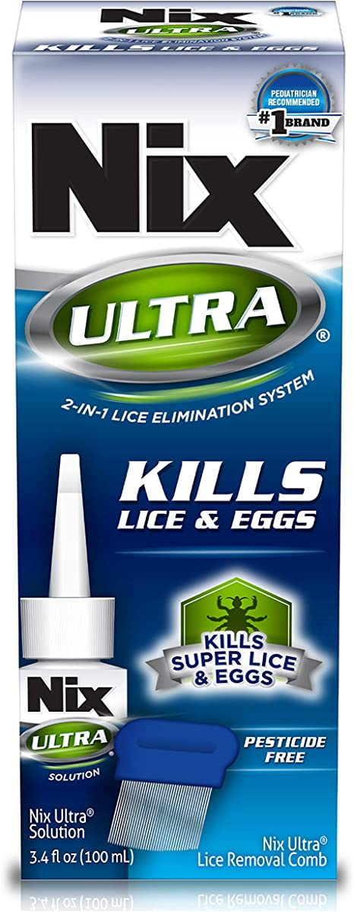
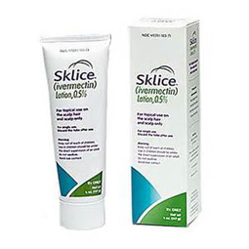
Over-The-Counter Pharmacologic Treatments
Permethrin 1% lotion
Elimite®, Nix ®
Pyrethrin + piperonyl butoxide
Rid ®, Pronto ®, Licide®, Lice- X®
Ivermectin 5% lotion
Sklice ®
Dimethicone 4% solution
Nix Ultra ®
Isopropyl myristate
Resultz ®
Notes:
Permethrin 1% Lotion. recommended first-line therapy. minimal toxicity and a well-studied safety profile. Permethrin acts as a neurotoxin and cause paralysis of the head lice although it is not ovicidal and therefore requires retreatment 7 to 10 days (optimally 9 days) after the initial treatment to kill newly hatched eggs if live lice are seen. The concern it has increasingly been found to be resistant to headlice in many regions. Application is straightforward as the cream rinse is applied to damp hair and scalp for 10 min and then rinsed with water. It can be used on children 2 months and older.
Pyrethrin 0.3% + Piperonyl Butoxide 4%. Pyrethrins have also been found to be safe with minimal toxicity and work similarly to permethrin by causing neurotoxic effects to the louse. They also require reapplication in 7 to 10 days as they are not ovicidal. Pyrethrin is made from chrysanthemum extract and therefore those who are allergic to this plant should not use it; there is a possible cross-contamination with ragweed as well so caution with ragweed allergies is indicated. The cream is applied to dry hair and left in place for 10 min and then rinsed with water. It is safe and approved for those older than 2 years of age. Resistance has been identified in many communities
Ivermectin 0.5% Lotion. Ivermectin 5% lotion has recently been moved from prescription to over-the-counter approval . Ivermectin is an anthelmintic that kills both live lice and damages the developing nit, so it is unable to feed upon birth; therefore, a second application is not necessary. Few adverse reactions have been found with Ivermectin lotion and it is approved for those 6 months and older. The lotion is applied to dry hair, left in place for 10 minutes, and then rinsed out with water.
Dimethicone Solution 4%. Dimethicone solution 4% also contains mineral oil and acts to suffocate lice. It is applied to dry hair and left in place for 30 min and repeated in 8 to 10 days since it does not have ovicidal activity. It is not indicated for those younger than 2 years of age.
Isopropyl Myristate. Isopropyl myristate works by destroying the shell of the louse. It is applied to dry hair and rinsed out after 10 min. It should be repeated in 8 to 10 days since it is not ovicidal. Isopropyl myristate is not recommended for those

Slide 9
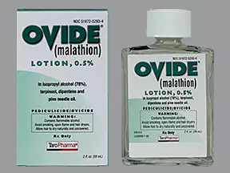
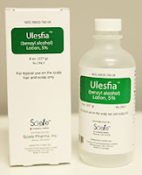
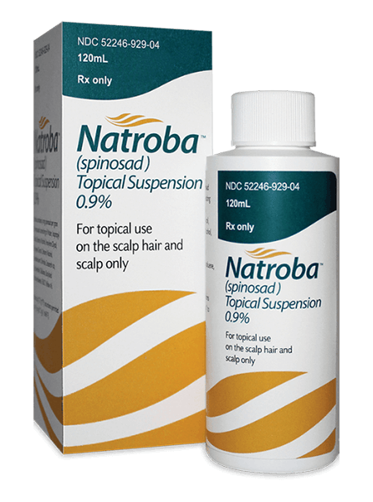
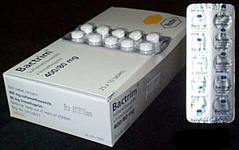
Prescription Pharmacologic Treatments
Benzyl alcohol 0.5% lotion
Ulesfia®
Malathion 0.5% lotion
Ovide ®
Spinosad 0.9% topical suspension
Natroba ®
Abametapir 0.74% lotion
Xelglyze ®
**Oral Ivermectin**--Off label use
Stromectol ®
**Oral sulfamethoxazole-trimethoprim**--Off label use
Bactrim ®, Spectra ®, Sulfatrim ®
Notes:
Benzyl alcohol 0.5% lotion acts to kill lice by asphyxiation. It is only approved for those over 6 months and should not be used in neonates. It is not ovicidal, so a second treatment is needed 7 days after the initial treatment so the new lice cannot lay eggs (Ogbuefi & Kenner-Bell, 2021). It is applied to dry hair so as to saturate the entire scalp and length of hair, left in place 10 min, and then rinsed out.
Malathion 0.5% lotion has been on and off the market in the United States for years due to its flammable properties. Malathion is pediculicidal and ovicidal (cholinesterase inhibitor) so only requires a second application if live lice are seen after 7 to 9 days. It is applied to dry hair and left in place for 8 to 12 hr before being rinsed off. It should not be dried with a hairdryer, any flat/ curling iron, and adults should not smoke around those who have it applied as it contains a high amount of alcohol and is flammable. It is contraindicated in those less than 2 years of age, and safety profiles are not complete in those less than 6 years of age. Malathion lotion used in the United States is a different preparation (with less resistance) than products found and used in other countries.
Topical Suspension. Spinosad acts broadly on lice by disrupting neural activity. It is a pediculicide with ovicidal activity; therefore, retreatment is only necessary if live lice are seen. Nit removal is not necessary if this suspension is used. It is applied to dry hair for 10 min and rinsed off. Safety has not been established in those less than four years of age.
Abametapir 0.74% lotion is a recently approved treatment that disrupts the development of the louse and its eggs. It is applied to dry hair for 10 min and then rinsed. It is approved for those 6 months and older and is highly effective with one treatment.
Oral Ivermectin has been used, off-label, at doses of 200 to 400 micrograms/kg with a repeat dose in 7 days. It is an anthelmintic that has the potential to cross the blood-brain barrier, disrupting neural transmission in the host, and therefore should not be used in those weighing less than 15 kg.
Off-label Use. Sulfamethoxazoletrimethoprim, an antibiotic, has also been used as an off-label treatment for head lice. It appears to have a toxic effect on the gut microbiota of the louse which leads to its death. It may be used alone or in combination with permethrin 1%

Slide 10
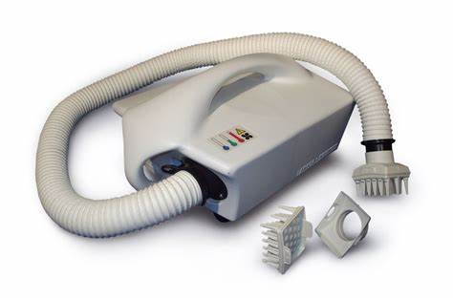
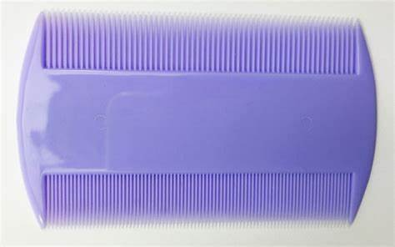
Alternative & Non-Pharmacologic Treatments
Essential Oils
Many different oils have been used. Efficacy has not been studied
Some products can be toxic
Occlusive agents
Mayonnaise, Olive Oil, Petroleum jelly, butter. Efficacy not studied.
Difficult to remove
Desiccation
LouseBuster™
Costly device, requires training
Manual removal
Tedious, but safe
Vinegar may help loosen
Notes:
Essential oils have gained much popularity in recent years and have been seen as “natural” or “alternative” treatments for many conditions. However, essential oils are not required to meet FDA regulatory standards for efficacy or safety and have a wide variability in content and constitution across suppliers. Therefore, doses are not consistent or standardized, which makes treatment efficacy difficult to identify. In addition, some essential oils have demonstrated toxicity in mammals even though they may be considered “environmentally friendly” or “natural”. Currently, few studies exist that have evaluated the efficacy of essential oils in the treatment of head lice.
The use of an occlusive application such as petroleum jelly, olive oil, butter, and mayonnaise has also been used in the treatment of head lice. Few efficacy studies exist on these products. Although these products would generally be considered safe to apply, applications need to be left in place for long periods of time to “suffocate” the lice. In addition, removal of these products can be difficult and “messy”.
Desiccation is the use of hot air to kill the lice and nits. This requires the use of a special dryer machine and trained provider to use the equipment. . LouseBuster™ is a currently marketed piece of equipment that provides this treatment. It was found to have over 90% mortality of lice and nits after use by a trained operation.
Manual removal of nits and lice is a tedious, time consuming, but safe treatment option. Nit loosening vinegar-based products may be helpful but should not be used in combination with permethrin as it reduces the effectiveness of permethrin. In some areas, nit removal services are available, but the hourly cost of this option can be significant. Shaving the head is an option for treatment but can have serious effects on self-esteem and be stigmatizing.

Slide 11
Implications for School Nursing
No identifiable health threat. Not a communicable disease.
Exclusion from school for lice OR nits is not recommended.
NASN, AAP, CDC have all said this.
Transmissibility in the classroom setting is low.
AAP just reaffirmed this in Oct, 2022 publication (Pediatrics. 2022 Oct 1;150[4]:e2022059282)
No need to bag clothing or items
Do not live long off host and most remain on the host.
Classroom and “mass” screenings have psychosocial implications
Not recommended.
Individual communication is recommended
Do not send home letters to entire
class or school

Slide 12
Education
No conditioners prior to/after treatment.
Vinegar may decrease effectiveness
Saturate scalp with product—leave in correct amt of time
Launder bedding, clothing to 130℉ and dry in drier
What cannot be laundered—bag for 2 weeks
Pediculicide sprays not necessary—safety concern
Retreatment in 7-10 days may be necessary (mark calendar)
Family members and household contacts should be checked at home
Products with kerosene, gasoline, or mercury are not recommended.

Slide 13
Case Study: Treatment and Education
There is an 8 year old female who has been noted by the teacher to have “something in her hair” and is sent to the nurse’s office for assessment. The nurse checks the hair behind the ears and at the nape of the neck and notes empty lice egg casings. Upon further assessment, the nurse notes several live lice. This child has not been treated for lice before. The parent asks the school nurse what is recommended. They ask if they need to have an exterminator come to the home.
What would might the nurse recommend?
What type of education might the nurse provide about treatment?
What is the recommendation for school attendance?
Notes:
The nurse should notify the parent individually. No mass communication.
Try permethrin or pyrethrin + piperonlyl butoxide. Both OTC and recommended first line treatments
Depending on which is used, permethrin is applied to damp hair and pyrethrin to dry.
Both rinsed after 10 min. No conditioner. Should be repeated in 7-10 days as both are not ovicidal.
Check other household members. Avoid pyrethrin if allergic to chrysanthamums.
Launder bedding and clothing in 130 degree and dry in drier. Bag any stuffed animals or items that cannot be laundered which may be infected. Nit removal is optional but might help if desired. Use fine tooth comb.
No need for exterminator or sprays for furniture.
No school needs to be missed.
Social aspect:
The nurse needs to address the social stigma of having lice as well. The student and parent need to be reassured that getting lice does not mean they are dirty. Actually, lice prefer a clean head. It Is very common for people to contract lice. I offer to help check anyone else in the household and teach them what to look for if they were able to come to my office and let them know they could call for questions. Sympathizing with the family goes a long way. Many families are embarrassed and don’t ask for help prolonging the process.

Slide 14
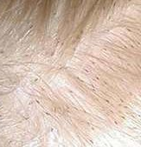
Case Study: Treatment Failure
The nurse is working with a child who has had repeated cases of lice this school year. The child currently has nits, egg casings, and live lice in the hair.
The parent states they have used all the following in the last few months and they have not worked: Rid, Elimite, Nix, and Lice-X and none have worked as the lice keep coming back. Parent says they apply it and then 2-3 weeks later they find “a bunch of lice” again.
The child has a brother who now has it too.
What might the nurse recommend?
What education do you identify as essential?
Notes:
Elimite and Nix are the same thing: Permethrin 1 % lotion and should be repeated in 7-10 days. Resistance has been found.
Lice-X and Rid are pyrthrin and piperonyl butoxide which also seems to have community resistance. Also requires retreatment.
Consider a different product with less resistance—such as Ivermectin 5% lotion. Also, this may not need retreatment—it may be reinfection. Apply to dry hair
Dimethicone 4% solution and Isopropryl myristate may also be options but they will more likely require retreatment in 8 -10 days.
Could consider reaching out to HCP for a prescription treatment as well especially with a product that does not require retreatment in 7-10 days.
Education: retreatment and recheck for lice during 7-14 day time period is necessary.
Ask how old is the brother?
Other education as needed—check combs, bedding, etc. NO conditioner, saturate scalp, leave on 10 minutes, education focused on which product used.
Also consider….is it treatment failure or is it reinfection? Check other household members.
Sleepovers?
Nit removal may be helpful too.

Slide 15
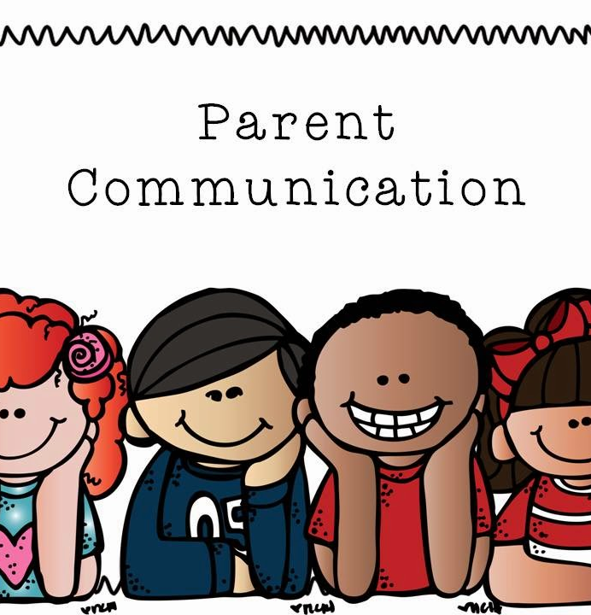
Case Study: Family Communication
A student was sent to the nurse’s office for excessive scratching of the scalp. Upon assessment, the nurse notes both live lice and nits present. This student has had lice before and has also had treatment failure for lice. The family has not followed through with retreatment on occasion and has been angry in the past when the nurse has contacted them about lice.
What are some ways to communicate with the family about the findings and recommendations?
Notes:
Know your school policy and make sure your administrator is current on the problem you are encountering.
- Many times, after talking with the family, the cost of the product would be the problem. Sometimes referral to the physician where a prescription may cost less than the OTC treatment product.
Then, I would follow up and see the student in my office daily to help the parents pick nits, communicating with them every day until the problem was resolved.
So much of this is developing working relationships with families and being willing to go that extra mile. In the end, the student is the one who benefits from your efforts as lice often affects their mental and social life as well as being a physical nuisance.
Most often the anger is about the situation that they are having trouble solving. So working with them to help them solve the problem goes a long way.

Slide 16
Case Study: School Communication
The same student (from the previous case who was sent to the nurse's office with scratching) is being sent back to class. The classroom teacher is upset and worried that the student will spread lice to the entire class and possibly them. The teacher does not want the student back in class the rest of the day. The teacher is also asking for bags so all student belongings can be bagged in the classroom.
What are some ways to address the teacher’s concerns?
Notes:
Communication is KEY!
- Again, knowing your school policy and having your administrator’s support in this scenario is essential.
- Although this is a tough and uncomfortable scenario, it is a great educational opportunity for staff.
Educate the teacher about lice, why things are done as they are (use various studies to back up your points) and remind the teacher that this is a confidential matter.
In no way can we discuss the health of another student with others in this situation.
Ensure the teacher that you are willing to check anyone in the class that has symptoms of lice and you will work with families one on one as needed.

Slide 17
Case Study: School Policy
The school nurse works in a school where lice have become a problem this academic year. Multiple students in multiple classrooms have had lice. The administrator is feeling pressure from the teachers to develop a policy with regard to school attendance and lice. They have written a “no nit” and no live lice policy without the nurse’s input and have informed the school nurse that students with lice will be sent home until free of live lice and nits.
How can the nurse address this issue? What recommendations do you have?
Notes:
Educate the administrator on the health aspects of lice and that they pose no health danger. Attempt to gain support. Provide statements from NASN, CDC, AAP that support allowing students to attend school with lice/nits.
Identify concerns related stigmatizing students and that this policy may result in over treatment and further resistance in the community.
Discuss loss of academic time that occur with no nit policies. Provide evidence/studies related to these issues (journal articles, etc). Look to other districts that are using policies that do not limit attendance.
Provide education to other staff members about the same.
Work to establish a policy district wide if once does not exist related to school attendance and lice. Use other districts policies as template.

Slide 18
Helpful Resources
NASN Statement on Head Lice Management in Schools
Support for eliminating No Nit policies in schools
www.nasn.org
CDC
Provides recommendations on school attendance and head lice
Provides treatment recommendations
https://www.cdc.gov/parasites/lice/head/index.html
AAP
Multiple publications on treatment and recommendations for head lice
www.aap.publications.org
www.healthychildren.org
Missouri Department of Health and Senior Services
www.health.mo.gov

Slide 19
Contact Information
Margaret Bultas, PhD, RN, CNE, CNL, CPNP-PC
Trudy Busch Valentine School of Nursing
Saint Louis University
margaret.bultas@health.slu.edu

Slide 20
References
Aralez Pharmaceuticals (2019). Resultz® Isopropryl Myristate Rinse. https://www.miravohealthcare.com/wp-content/uploads/2020/11/Resultz-CM-ENG-April-2019.pdf
Bohl, B., Evetts, J., McClain, K., Rosenauer, A., & Stellitano, E. (2015). Clinical practice update: Pediculosis capitis. Pediatric Nursing, 41(5), 227. http://www.pediatricnursing.net/ce/2017/article4105227234.pdf
Bush, S. E., Rock, A. N., Jones, S. L., Malenke, J. R., & Clayton, D. H. (2014). Efficacy of the LouseBuster, a new medical device for treating head lice (Anoplura: Pediculidae). Journal of Medical Entomology, 48(1), 67-72. https://doi.org/10.1603/ME10122
Candy, K., Akhoundi, M., Andriantsoanirina, V., Durand, R., Bruel, C., & Izri, A. (2020). Essential oils as a potential treatment option for pediculosis. Planta Medica, 86(09), 619-630. https://doi.org/10.1055/a-1161-9189
Centers for Disease Control [CDC]. (2015). Head lice information for schools.
https://www.cdc.gov/parasites/lice/head/schools.html
Centers for Disease Control [CDC]. (2019a). Body Lice. https://www.cdc.gov/parasites/lice/head/treatment.html
Centers for Disease Control [CDC]. (2019b). Head lice: Biology.
https://www.cdc.gov/parasites/lice/head/biology.html
Centers for Disease Control [CDC]. (2019c). Head lice: Diagnosis.
https://www.cdc.gov/parasites/lice/head/diagnosis.html
Centers for Disease Control [CDC]. (2019d). Head lice: Treatment. https://www.cdc.gov/parasites/lice/head/treatment.html
Centers for Disease Control [CDC]. (2020). Head lice: Frequently Asked Questions (FAQS). https://www.cdc.gov/parasites/lice/head/gen_info/faqs.html
Devore, C. D., Schutze, G. E., The Council on School health and committee on infectious disease, Okamoto, J., Allison, M., Ancona, R., Attisha, E., De Pinto, C., Holmes, B., Kjolhede, C., Lerner, M., Ninier, M, Weiss-Harrison, A., Young, T, Byington, C. L, Maldanado, Y. A., Barnett, E. D., Davies, H.D., Edwards, K. M, ... Zaoutis, T. E. (2015). Head lice. Pediatrics, 135(5), e1355-e1365. Reaffirmed June 2020. https://publications.aap.org/pediatrics/article/135/5/e1355/33653/Head-Lice

Slide 21
References
Feldmeier, H. (2014). Treatment of pediculosis capitis: A critical appraisal of the current literature. American Journal of Clinical Dermatology, 15(5), 401-412. https://doi.org/10.1007/s40257-014-0094-4
Gunning, K., Kiraly, B., & Pippitt, K. (2019). Lice and scabies: Treatment update. American Family Physician, 99(10), 635-642. https://www.aafp.org/afp/2019/0515/p635.html
Hurst, S. K., Dotson, J. A. W., Butterfield, P., Corbett, C. F., & Oneal, G. (2020, April). Stigma resulting from head lice infestation: A concept analysis and implications for public health. Nursing Forum 55(2), 252-258). https://doi.org/10.1111/nuf.12423
Kamath, S., & Kenner-Bell, B. (2020). Infestations, bites, and insect repellents. Pediatric Annals, 49(3), e124-e131. https://doi.org/10.3928/19382359-20200214-01
Imboden, A. (2019). Effective treatments for head lice. The Nurse Practitioner, 44(9), 36-42. https://doi.org/10.1097/01.NPR.0000574668.19239.db
National Association of School Nurses [NASN]. 2020. Head lice management in schools (Position Statement). https://www.nasn.org/nasn-resources/professional-practice-documents/position-statements/ps-head-lice
Ogbuefi, N., & Kenner-Bell, B. (2021). Common pediatric infestations: Update on diagnosis and treatment of scabies, head lice, and bed bugs. Current Opinion in Pediatrics, 33(4), 410-415. https://doi.org/10.1097/MOP.0000000000001031
Oung, A. B. (2018). Is oral ivermectin an effective treatment option for refractory pediculosis capitis?. Evidence-Based Practice, 21(9), 15. https://doi.org/10.1097/EBP.0000000000000069
Sanchezruiz, W. L., Nuzum, D. S., & Kouzi, S. A. (2018). Oral ivermectin for the treatment of head lice infestation. The Bulletin of the American Society of Hospital Pharmacists, 75(13), 937-943. https://doi.org/10.2146/ajhp170464
Vassantachart, J. M., Florentino, A., & Admani, S. (2021). Lice infestations in the pediatric population. Journal of the Dermatology Nurses' Association, 13(5), 284-287. https://doi.org/10.1097/JDN.0000000000000636
Webber, E., & McConnell, S. (2018). Lice update: Management and treatment in the home. Home Healthcare Now, 36(5), 289-294. https://doi.org/10.1097/NHH.000000000000067

